Slide 1
Escape Room
Nicolai Cardinale

Slide 2
Escape The Room
A simple escape the room game involving one room and multiple puzzles in order to solve to escape.
Will have an inventory system at the bottom to hold items that you have for later use of either using or combining materials you find throughout the room.
No story right now, but might be telling a subtle story within the game later
Might want to add interesting puzzles involving increments of time.

Slide 3
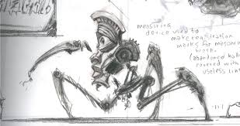
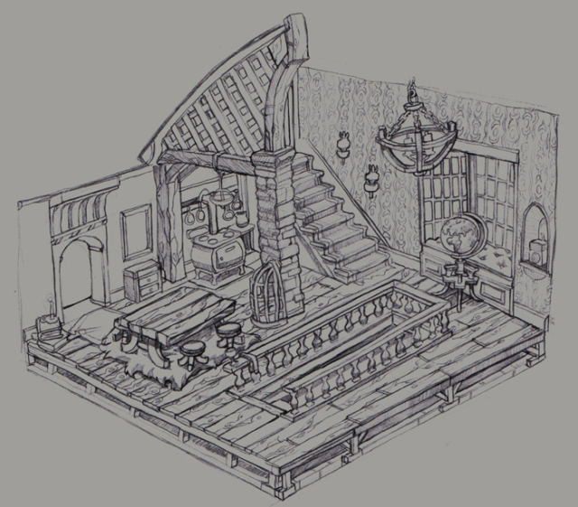
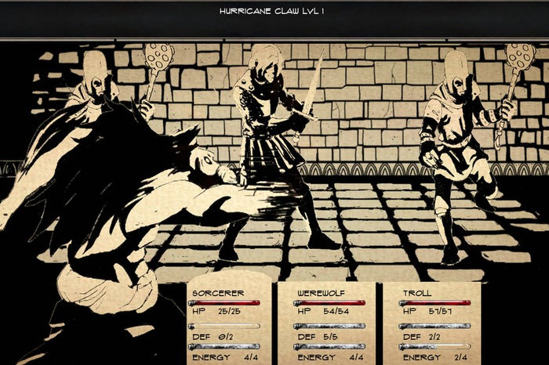
Aesthetic

Slide 4
Sight/Game Map
Cabinet
Main Doorway
(Start)
Window
Painting
Each one of these will have different items and tools.
Keys
Code
Stick + Gum

